Slide 1
8259A PRIORITY INTERRUPT CONTROLLER

Slide 2
8086 has 2 interrupt inputs
1. NMI
2. INTR
For application where we have interrupts from multiple sources, use an external device called a Priority Interrupt Controller(PIC) to “funnel” the interrupt signals into a single interrupt input on the processor.

Slide 3
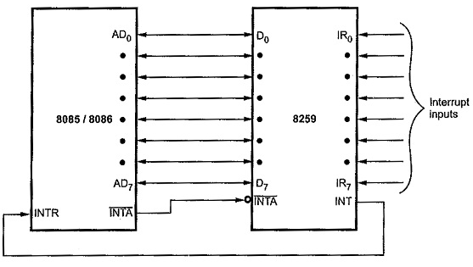
8259A Overview and system connection

Slide 4
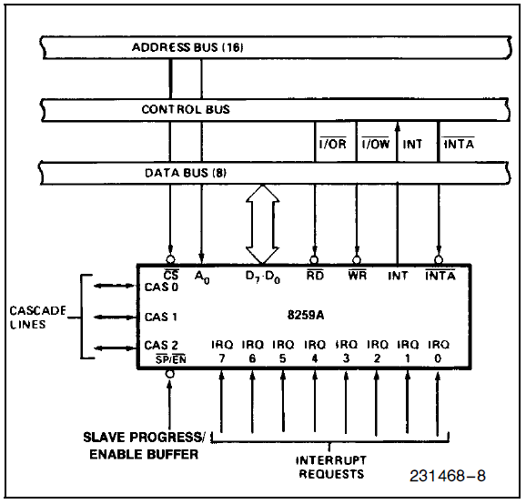
Connection with System Bus

Slide 5
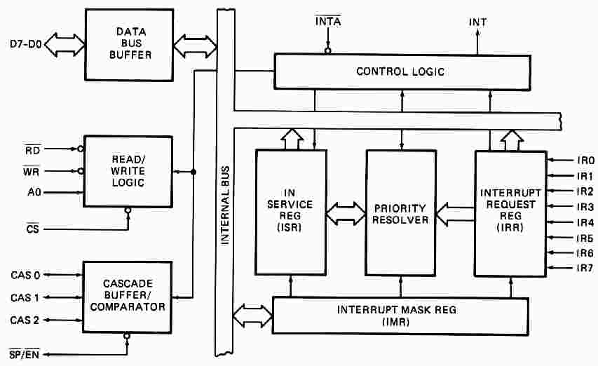
8259A PIC
HIGH
Low
Notes:
Can come

Slide 6
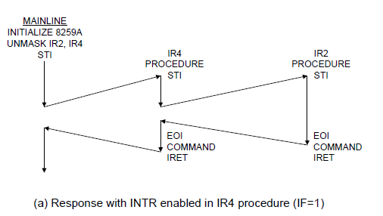
Notes:
imp

Slide 7
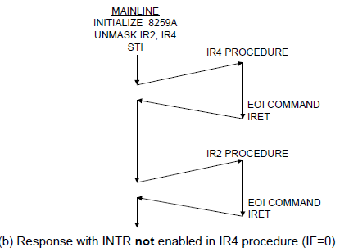

Slide 8
Master and slave
Master → The 8259A connected directly into the 8086 INTR pin is called as master
Slave (Cascaded)→ The INT pin from the other 8259A connects into an IR input on the master. This secondary or cascaded device is called as a slave
Cascading
More than one 8259 can be added to a system
An 8259 can be connected to each IR inputs of the master 8259 to give a total of 64 interrupts input

Slide 9
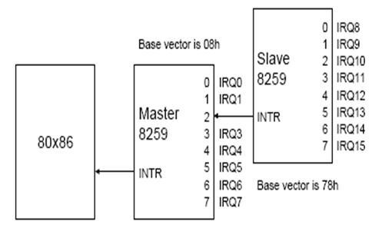
Master Slave Configuration

Slide 10
Programming the 8259A
The 8259A is programmed by properly initializing:
- 4 ICWs - Initialization command words;
- 3 OCWs – Operation command words;
The initialization procedure may not need to initialize all of them.
Notes:
iMp

Slide 11
Initializing an 8259A
Find the system base address
Find the internal address (two internal addresses selected by high or low on A0 pin)
System address=internal address + base address

Slide 12
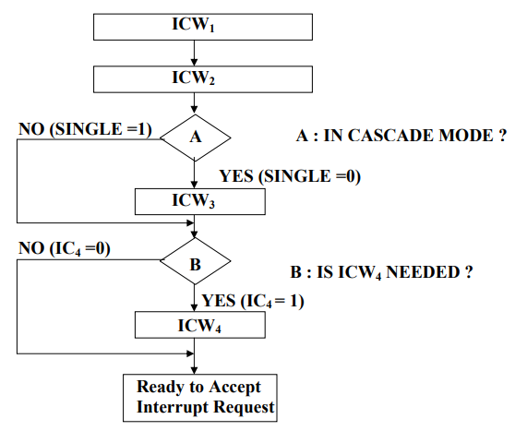
Programming 8259

Slide 13
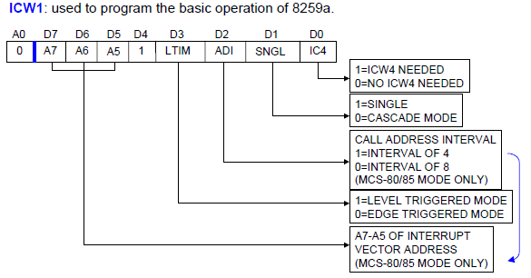
ICW1

Slide 14
ICW2

Slide 15
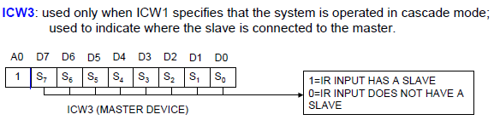
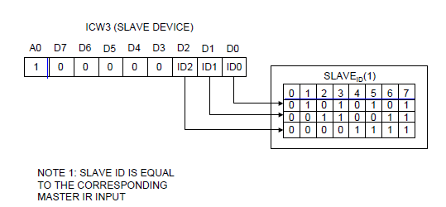
ICW3

Slide 16
ICW4

Slide 17
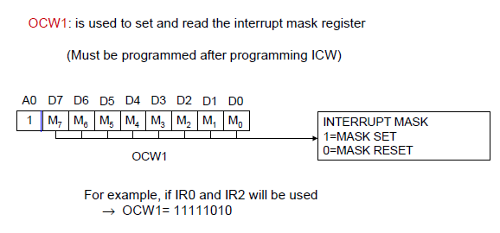
OCW1

Slide 18
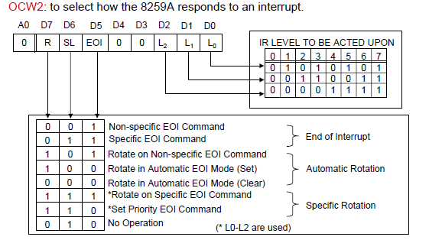
OCW2

